Slide 1
‘Partners in Health’
7th Global Pharmacy Technicians’ Symposium
Glasgow, UK
1 - 2 September 2018
Join us in Glasgow!
www.congress.pharmacy

Slide 2
Join us at the 7th Global Pharmacy Technicians’ Symposium!
The 2018 Symposium in Glasgow, themed “Partners in Health”, will provide an opportunity to explore
a variety of new practice initiatives underway in a variety of countries, and the barriers and facilitators impacting the development of this portion of the pharmaceutical workforce.
Final registration deadline: 1 August 2018
For more information: education@fip.org

Slide 3
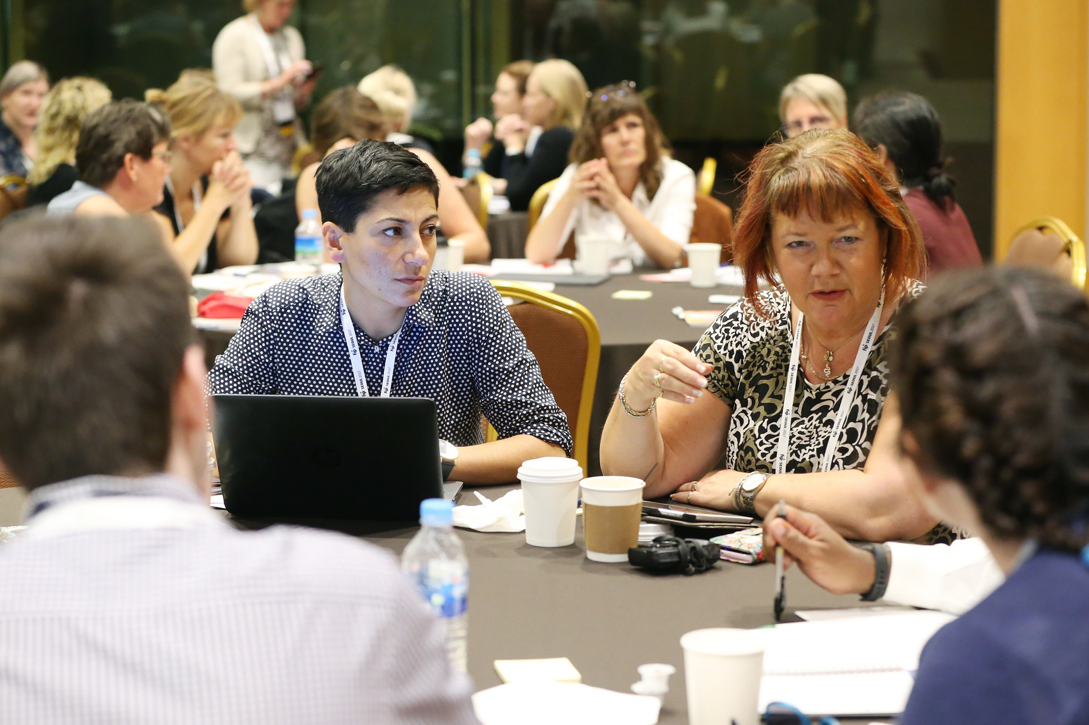
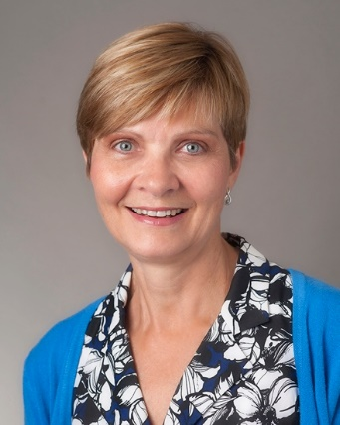
Register now and bring a colleague for free!*
Early bird registration: 15 May 2018
For the first time, participants will have two streams to choose from!
“We are excited to offer one stream focused on pharmacy technician practice roles and another on the development of the pharmacy support workforce, equipped to meet the needs of the broader health care system”
www.congress.pharmacy
Susan James
Programme Chair of the Symposium
* For stand-alone registration only

